Slide 1
SIGNS WITH SMART CONNECTIVITY FOR BETTER ROAD SAFETY
MANIGANDAN S - 1904088
VARUN KARTHIK T - 1904120
VENKAT RAMANAN M - 1904121
HARIHARAN S - 2004206

Slide 2
OBJECTIVE
The main aim of this project is to make the sign boards dynamical, that are on road sides, to efficiently manage the signs according to the situation.
‹#›

Slide 3
NEED FOR THE PROJECT
The sign boards, that display the same information every time are not apt to the situation around them.
So they need to be made dynamical, by which we can manage the information provided on them likely time , weather – basis and etc.,
For example- considering a scenario, where we need to alert the driver to limit the speed of their vehicles, while passing the school at the particular time intervals (starting, ending of schools)..
For this purpose, the dynamical sign board can be used efficiently by managing them on time – basis.
‹#›

Slide 4
EXISTING SOLUTION
The sign boards that are on road sides are static, and they alert the driver everytime with the same information provided on them.
‹#›

Slide 5
LITRETURE SURVEY
S.NO | TITLE | MODEL / TECHNIQUES USED | MERITS/ DEMERITS | OUTCOMES
1. | Chetan Dhule et al.,(2021), “Study of Design of IoT based Digital Board for Real Time Data Delivery on National Highway,” in Electronics and Telecommunication Engineering Department,G H Raisoni College of Engineering, Nagpur | Led based digital boards, Weather based, Solar power, Cloud, Database | MERITS Power Saving, Smart Connectivity, Cloud Based Model, | The proposed system is very powerful and very beneficial for travelers
2. | Devershi Pallavi Bhatt, Manish Tiwari, (2019), “Smart Traffic Sign Boards (STSB) for Smart Cities,” University of Bahrain | STSB, UHF - RFID | MERITS Economical, Easy Connectivity | Intelligent traffic management and driving assistance for the new driver for a particular area or city
‹#›

Slide 6
LITRETURE SURVEY
S.NO | TITLE | MODEL / TECHNIQUES USED | MERITS/ DEMERITS | OUTCOMES
1. | Songkran Kantawong, (2021), “Smart Solar Cell e-Warning Signs Board via on Cloud based Control for Social Distancing Alert,” Bangkok University | RGB Led boards, Solar power, NETPIE Cloud, Database | MERITS Power Saving, Smart Connectivity, Cloud Based Model, | a long distance access control is eastablished especially for social distancing policy caused by COVID-19
‹#›

Slide 7
INFERENCE
Information provided on the static sign boards cannot be changed easily, it must be re-established. Hence the cost goes high.
Static sign boards cannot be managed according to the situations.
‹#›

Slide 8
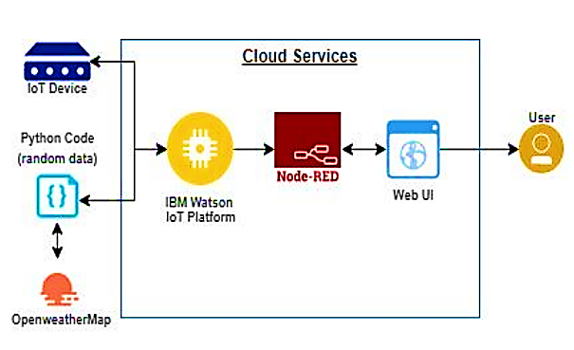
PROPOSED MODEL
‹#›

Slide 9
REFERENCES
[1] Yasir Mehmood (et al) “Internet-of-Things Based Smart Cities: Recent Advances and
Challenges” IEEE Communications Magazine Volume: 55 Issue: 9, pp. 16 - 24 (2017)
[2] Corke, Peter, et al. "Environmental wireless sensor networks." Proceedings of the IEEE 98.11 (2010): 1903-1917
[3] Kumari, Neha, Shivani Gosavi, and Sandeep S. Nagre. "Real-Time Cloud based Weather Monitoring System." 2020 2nd International Conference on Innovative Mechanisms for Industry Applications (ICIMIA). IEEE, 2020
‹#›

